Slide 1
Minimax Search
Adversarial Game Playing
Reading: Chapter 6

Slide 2
AI Search so far
States, actions, goals
Search techniques
  Blind (depth-first, breadth-first, IDS)
  Heuristic (best-first, A*)
  Local (hill-climbing, etc)

Slide 3
Adversarial Games
Search examples so far have concentrated on unopposed search problems (e.g. 8-square problem, eight queens, etc)
Game playing is a traditional focus for Artificial Intelligence
  Checkers (Samuels, 1959)
  Chess (Turing, 1957; Greenblatt, 1966)
  …
Must take account of the opponent

Slide 4
The Game Of Nim
Start with a single pile of seven matches
Each player takes it in turn to take a pile of matches and split into two differently-sized piles of matches
The last player who is able to make a move is the winner

Slide 5
The Game of Nim
Very small game
  Few legal states
  Few legal moves from each state
  Game doesn’t last long (few turns)
Player who plays second has an (unfair) advantage
Possible to construct a tree representing all the states of the game

Slide 6
Nim Game Tree
7
6-1
5-2
4-3
5-1-1
4-2-1
3-3-1
3-2-2
4-1-1-1
3-2-1-1
2-2-2-1
3-1-1-1-1
2-2-1-1-1
2-1-1-1-1-1

Slide 7
Nim Game Tree
7
YOU
ME
6-1
5-2
4-3
YOU
5-1-1
4-2-1
3-3-1
3-2-2
ME
4-1-1-1
3-2-1-1
2-2-2-1
YOU
3-1-1-1-1
2-2-1-1-1
ME
2-1-1-1-1-1

Slide 8
Game Tree Search
Initial state: initial board state
Goal state: winning positions
Actions: one for each legal move
Expand function: generate legal moves
Evaluation function: assigns score to each board state
Game tree: all possible games

Slide 9
Minimax Search
View of search in adversarial games
MAX is traditionally the computer player, and picks the moves whose heuristic value is the best (maximum)
MIN is the opponent, and picks moves that minimise MAX’s advantage

Slide 10
Nim Game Tree
MIN
7
MAX
6-1
5-2
4-3
MIN
5-1-1
4-2-1
3-3-1
3-2-2
MAX
4-1-1-1
3-2-1-1
2-2-2-1
MIN
3-1-1-1-1
2-2-1-1-1
MAX
2-1-1-1-1-1

Slide 11
Minimax Search
Search to a given ply (depth-limited search)
Evaluate heuristic for leaf nodes
Internal nodes propagate heuristic values towards tree root
  MAX nodes take the maximum of their child values (we make the best move we can)
  MIN nodes take the minimum of their child values (we assume our adversary makes the move that is worst for us)
Pick action with best guaranteed score

Slide 12
Minimax Algorithm
function MAX-VALUE(state, depth)
if (depth ==0) then return EVAL(state)
v = -∞
for each s in SUCCESSORS(state) do
v = MAX(v, MIN-VALUE(s, depth-1))
end
return v

Slide 13
Minimax Algorithm
function MIN-VALUE(state, depth)
if (depth ==0) then return EVAL(state)
v = ∞
for each s in SUCCESSORS(state) do
v = MIN(v, MAX-VALUE(s, depth-1))
end
return v

Slide 14
Minimax Example
MAX
MIN
MAX
4
6
3
2
8
3
1

Slide 15
Minimax Example
MAX
MIN
3
2
1
MAX
4
6
3
2
8
3
1

Slide 16
Minimax Example
MAX
3
MIN
3
2
1
MAX
4
6
3
2
8
3
1

Slide 17
Minimax Example
MAX
3
MIN
3
2
1
MAX
4
6
3
2
8
3
1

Slide 18
Minimax for Nim
We use an evaluation function that is:
  +1 for a winning move for MAX
  -1 for a winning move for MIN

Slide 19
Minimax for Nim
7
+1
MIN
MAX
6-1
+1
5-2
+1
4-3
+1
MIN
5-1-1
-1
4-2-1
+1
3-3-1
+1
3-2-2
-1
MAX
4-1-1-1
-1
3-2-1-1
+1
2-2-2-1
-1
MIN
3-1-1-1-1
-1
2-2-1-1-1
+1
MAX
2-1-1-1-1-1
-1

Slide 20
Properties of Minimax
Complete? Yes (if tree is finite)
Optimal? Yes (against an optimal opponent)
Time complexity? O(b^{m})
Space complexity? O(bm) (depth-first exploration)
For chess, b ≈ 35, m ≈100 for "reasonable" games
→ exact solution completely infeasible

Slide 21
Evaluation Functions
Typically a linear function in which coefficients are used to weight game features
Unlikely to be a perfect, computable evaluation function for most games
Games with uncertainty (backgammon, etc) add notions of expectation

Slide 22
Evaluation Functions
For noughts and crosses:
S = #(potential nought lines)
-#(potential cross lines)

Slide 23
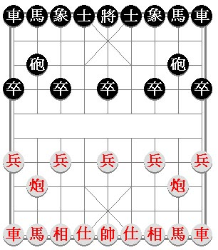
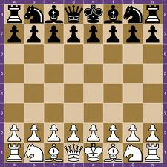
Evaluation Functions
For chess:
Any ideas?
Material is a good starting point
  e.g. S = (1 * numPawns) + (3 * numBishops) + …
  How do you decide on the weights?
Anything else?

Slide 24
Evaluation Functions
For chess:
S = c1 * material
c2 * pawn structure
c3 * king safety
c4 * mobility
…
Each of these can be another linear function

Slide 25
The Horizon Effect
Cannot exhaustively search most game trees
Significant events may exist just beyond that part of the tree we have searched
The further we look ahead, the better our evaluation of a position
If we’re searching the game tree to a depth of n ply, what happens if our opponent is looking n+1 moves ahead?

Slide 26
Quiescent Search
Bad evaluation function can lead to wild swings in behaviour
  Consider just material in chess (queen capture)
Look for stable (quiescent) positions
Can expand nodes in nonquiescent positions to a deeper ply, until a relatively stable situation is reached

Slide 27
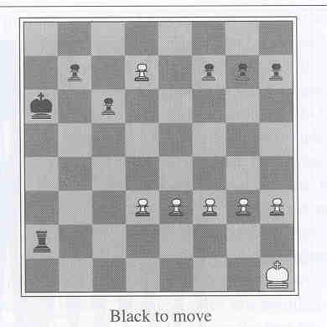
Single Extension
Consider this
A ply of 14 is needed to see the white pawn become a queen
Single extension is when one move is clearly better. (b=1!)

Slide 28
The importance of ply depth
USCF Rating
Deep Blue(1997)
2900
World champ
Belle (1977)
2000
Expert
MacHack (1966)
1200
4
5
6
7
8
9
10
11
12
13
Max ply depth

Slide 29
Branching Factor
The branching factor of a game is the number of actions which can be chosen
Nim has a low branching factor, but many games do not
  Chess (c. 36)
  Go (c. 200)
With game length (tree depth), affects complexity of decision making

Slide 30
Summary
Evaluation functions are core to adversarial games
  Usually a linear weighted function of easily computed game attributes
Minimax is the de-facto algorithm
  Ply depth very important
  Not efficient!

